Slide 1
HOW TO WRITE A RESOLUTION

Slide 2
What is a resolution?

Slide 3
TITLE
What is a resolution?
Formal request to change the constitution, election rule, policy or bylaw.
Considered by the Delegate Assembly
Democratic way to improve our union

Slide 4
Who can submit a resolution?

Slide 5
Who can submit a resolution?
Local and statewide executive committees
Locals
Statewide standing committees identified in the Bylaws
Board of Directors
Board of Trustees
Any two or more members

Slide 6
Who can write a resolution?

Slide 7
TITLE
Who can write a resolution?
Resolution writers may call upon members of the Constitution and Rules Committee for advice, but creating the resolution is the responsibility of the writer.

Slide 8
How do I format a resolution?

Slide 9
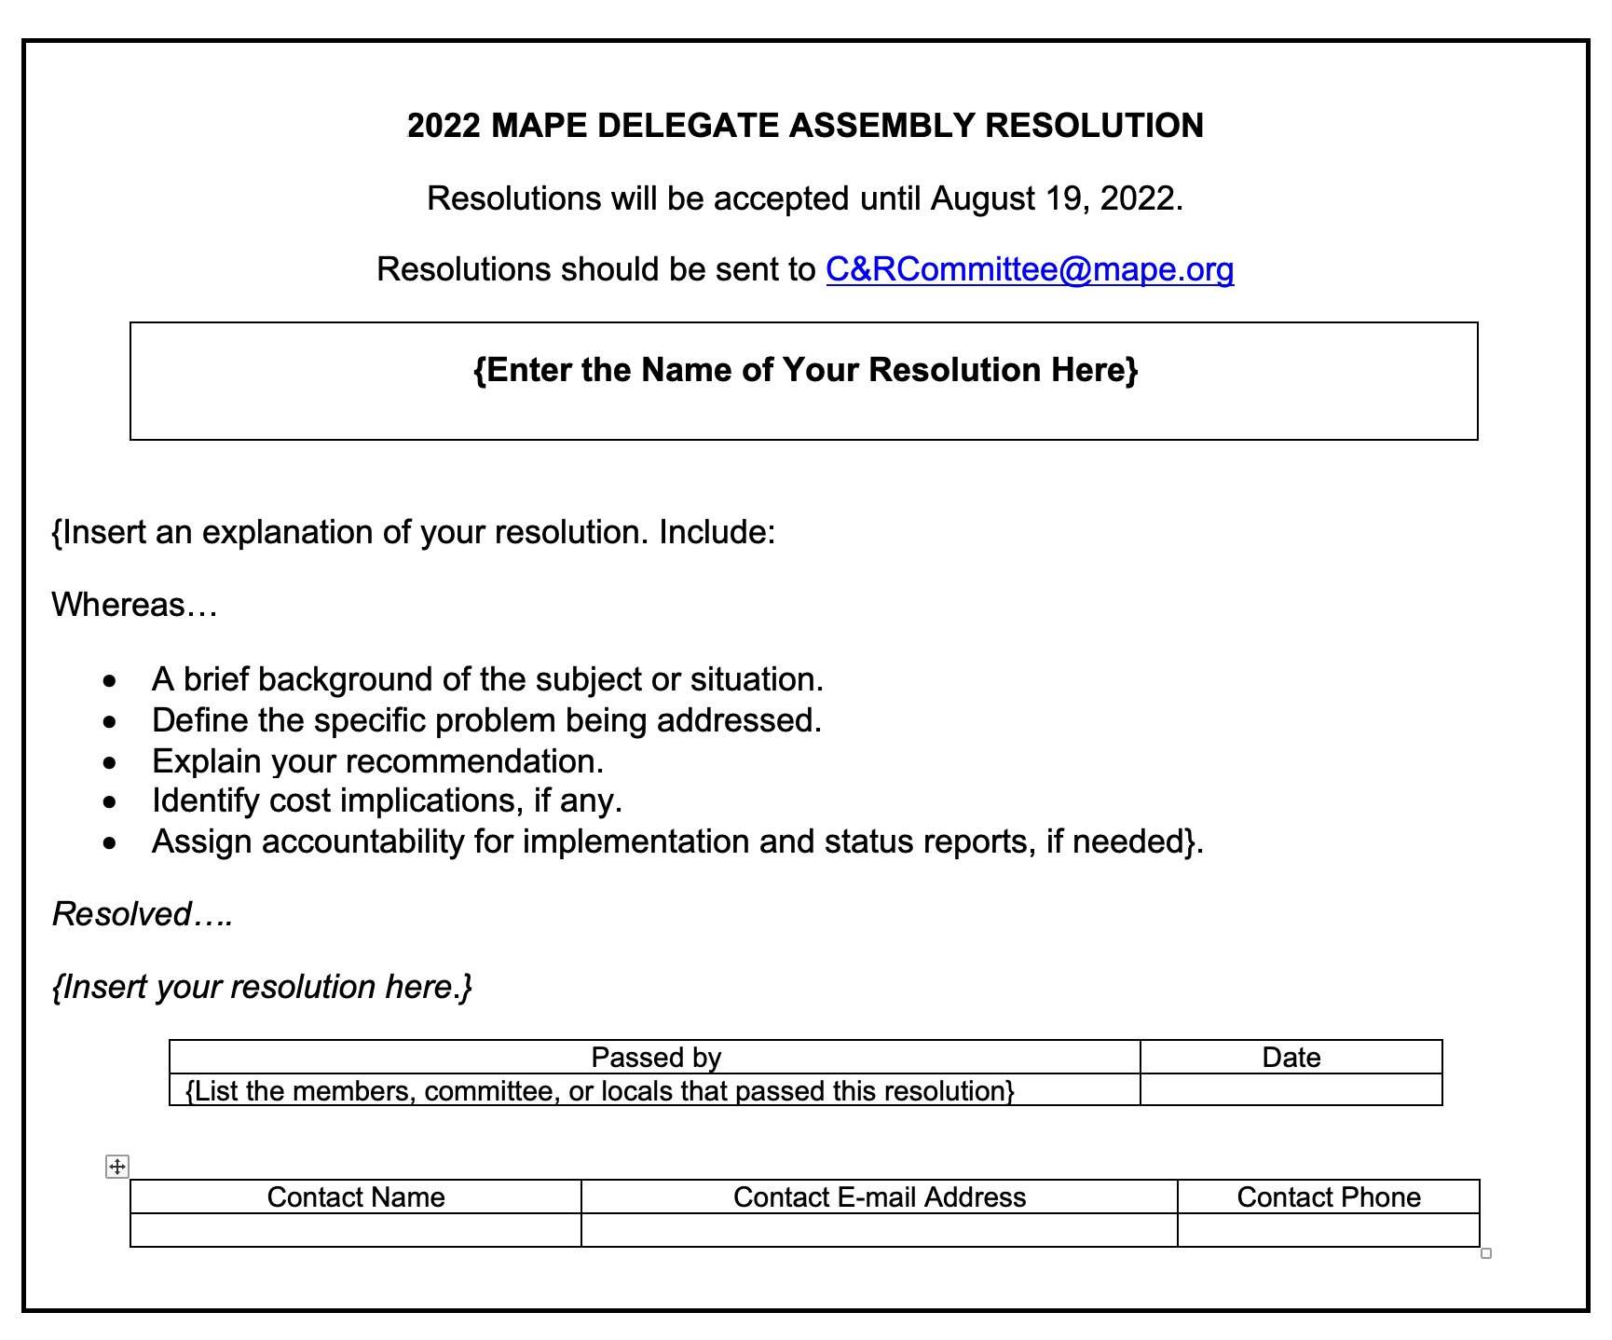
How do I format a resolution?
Resolutions must be on the template
provided on the MAPE website.
https://mape.org/committees/delegate-assembly-da​
Under "Delegate Assembly Resources"
Titled "Delegate Assembly Template"

Slide 10
How do I format a resolution?
Enter the name of your resolution.

Slide 11
How do I format a resolution?
Explain your resolution.
1. Begin with “Whereas…”
2. Provide a brief background of the subject or situation.

Slide 12
How do I format a resolution?
3. Define the specific problem being addressed.
4. Explain your recommendation.
5. Identify cost implications, if any.

Slide 13
How do I format a resolution?
6. Assign accountability for implementation and status reports, if needed.
7. Assign where the change would occur/be implemented.
8. Resolved…. (insert your resolution)

Slide 14
How do I format a resolution?
Enter the list of members or the committee, local, etc., that is proposing this resolution and the date the language was approved by this group.
After your resolution is written it can be reviewed and recommended by others as well. If there is time before the due date, they can also be listed here.

Slide 15
How do I format a resolution?
Include the lead member's contact name, email and phone.

Slide 16
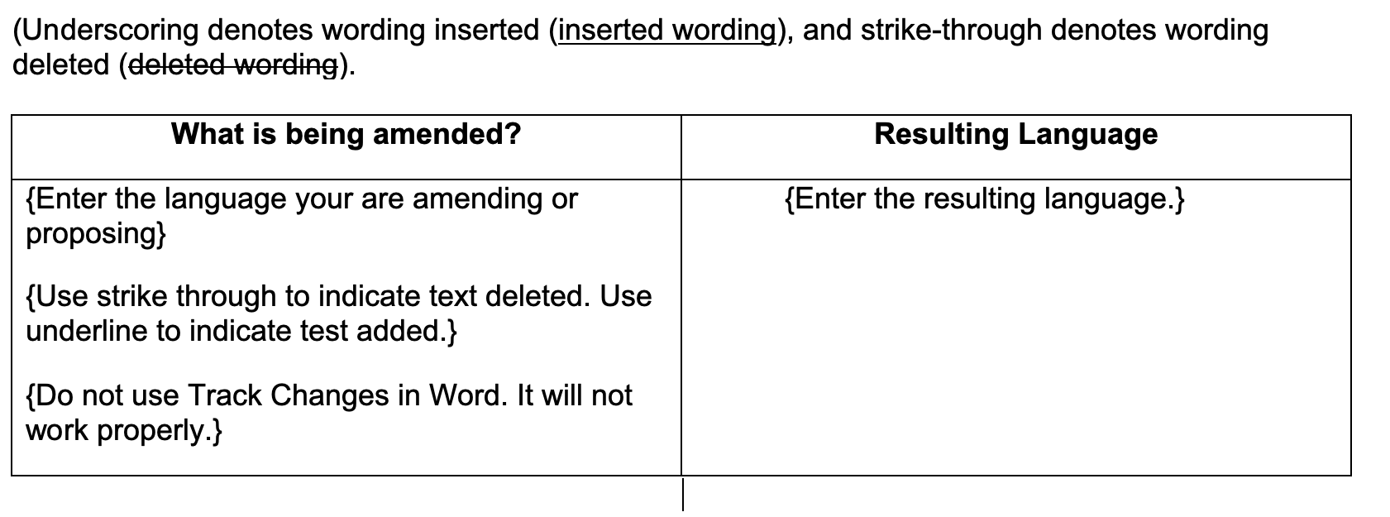
How do I format a resolution?
Complete the “What is being amended?” and “Resulting Language” boxes only if the resolution edits existing text. Otherwise these boxes can be deleted.

Slide 17
How do I format a resolution?
Note: (Underscoring denotes wording inserted (inserted wording), and strike-through denotes wording deleted (deleted wording).
Please change the format in Word instead of using Track Changes to make sure the changes are visible when it is reviewed and sent to delegates to consider.

Slide 18
How do I submit a resolution?

Slide 19
How do I submit a resolution?
Resolutions can be submitted beginning January 1 each year.
Check the MAPE website for the deadline.
Resolutions can be submitted to C&RCommittee@mape.org

Slide 20
What happens after I submit my resolution?

Slide 21
TITLE
What then?
The Constitution and Rules Committee will acknowledge, by e-mail, receipt of resolutions.
The email will include information about the Resolution Forums.

Slide 22
TITLE
Resolution Forum
Resolution Forum dates will be posted on the website Delegate Assembly page after they are set by the committee.
Your resolution will stand a better chance of being passed if an informed delegate will speak in favor of it and be able to explain it.

Slide 23
What then?
Time permitting, the Constitution and Rules Committee may contact a resolution’s submitter to suggest clarifying changes be made to a resolution, but the final wording will be that of the submitter.

Slide 24
How are members informed about proposed resolutions?

Slide 25
How are members informed?
The Constitution and Rules Committee approves resolutions by 30 days prior to DA and are then available on the MAPE website.
Resolutions are emailed to members.
Resolution forums are held.
As an author you should attend so you can speak to your resolution.

Slide 26
How is my resolution heard at DA?

Slide 27
How is my resolution heard at DA?
1. DA uses Robert’s Rules of Order
2. A motion is made to speak to your resolution.
3. You will then be given two minutes to speak to your proposed resolution.

Slide 28
How is my resolution heard at DA?
4. The DA will then hear:
Speakers will alternate those speaking against and for the motion.
Up to three members speaking against the resolution
Up to two more members speaking for the resolution

Slide 29
How is my resolution heard at DA?
5. Delegates can propose amendments to the resolution.
6. Members will have an opportunity to speak for or against the amendment.
7a. The amendment is then voted on.

Slide 30
TITLE
How is my resolution heard at DA?
7b. If no amendments, the resolution is voted on.
8. The motion will either pass or fail with a majority of votes most of the time; it takes a 2/3rds vote to make changes to the Constitution.

Slide 31
What if my resolution passes?
The board will work to implement all resolutions that passed.

Slide 32
What if my resolution fails?
You can always revise and submit again in the following year.
Take into consideration the feedback of why people did not support your resolution.

Slide 33
TITLE
Thank you!
We appreciate you being part of MAPE and an active role to shape your union!
Questions? Reach out to: C&RCommittee@mape.org

