Slide 1

Delegate Assembly
Caucus Training
September 19, 2025

Slide 2
TITLE
Goals of Political Council
Create and Maintain Statewide Political Infrastructure
Defeat Toxic Narratives Around Politics and State Service
Build MAPE’s Political Power and Competence

Slide 3

What is at stake?
What is the impact of the new contract on you and the people you love?
What’s on the line if we fail to push for a contract that takes us forward?

Slide 4
Level Setting - Why This Fight Was So Rough?
  Legislators chose budget cuts over taxing the rich, even as inequality grows.
  A broken health insurance system drove up costs, eating into wages and blocking other wins.
  The 32-hour workweek campaign inspired 2,500+ coworkers (including 300 non-members), but fear of public backlash and the budget deficit kept it off the table.
  A large number of members were forced back to the office after years of teleworking with little notice and no involvement in the decision.

Slide 5
Together we have power!
The legislature doesn’t just “happen” — we shape who represents us.
The state budget isn’t neutral — it reflects who we organize and fight for.
Public opinion isn’t fixed — we can move it if we act together.

Slide 6
Together we have power!
If we’re serious about winning real change for ourselves and the people we love,
contract bargaining alone is not enough.
We have to contest for power — in our workplaces, in the legislature, and in the streets.

Slide 7
Caucuses and Conventions 101

Slide 8
Four Levels of Caucus and Conventions
Precinct Caucus
Organizing Unit Convention
Congressional District Convention
State Convention

Slide 9
What is a caucus?
A meeting at a local community event space where neighbors get together to discuss issues and organize the local party unit.
A foundational pillar to grassroots political organizing because participation is open to every Minnesotan.
All parties have their caucuses on the same night.
The next precinct caucus date is Feb. 3, 2026.
Notes:
The process through which political parties determine their platforms and endorse candidates.
Caucusing MATTERS. A small group of people determine endorsements and orient candidates on how they will lead.

Slide 10
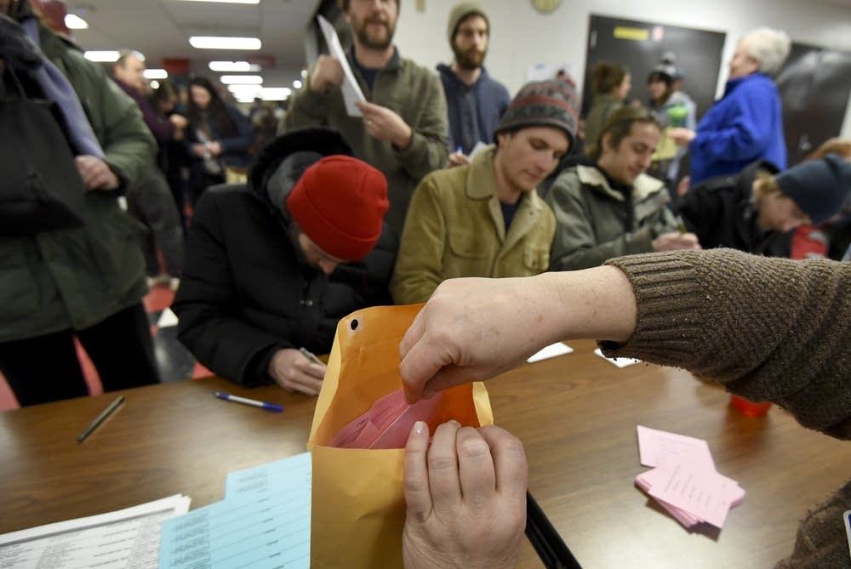
What Happens at a Caucus?
Meet your neighbors
Elect Delegates and Alternatives
Consider Resolutions
A caucus volunteer stuffs ballots into a full envelope during the DFL Caucus at St. Paul's Central High School in 2016.
Richard Marshall for MPR News 2016
Notes:
Register
Meet your neighbors
Elect a Caucus Chair andSecretary
Elect two Tellers who helpcount votes
Elect Precinct Chairs andVice Chairs
Elect Delegates andAlternatives
Consider Resolutions
Find Your Caucus Location → https://caucusfinder.sos.state.mn.us
February 1: Caucus Day
Attend precinct caucus (arrive by 7pm)
Submit Resolution
RAISE YOUR HAND to become a delegate to endorsing conventions
Senate District Convention (to endorse candidates for House and Senate)
County Convention (to endorse candidates for County Attorney, Sheriff, Commissioner)
Organizing Unit Convention
DFL Only: Non-Attendee Form
Submit this form via email to your district chair by January 29
Drop off this form at your caucus location on February 1, 6:30-9pm

Slide 11
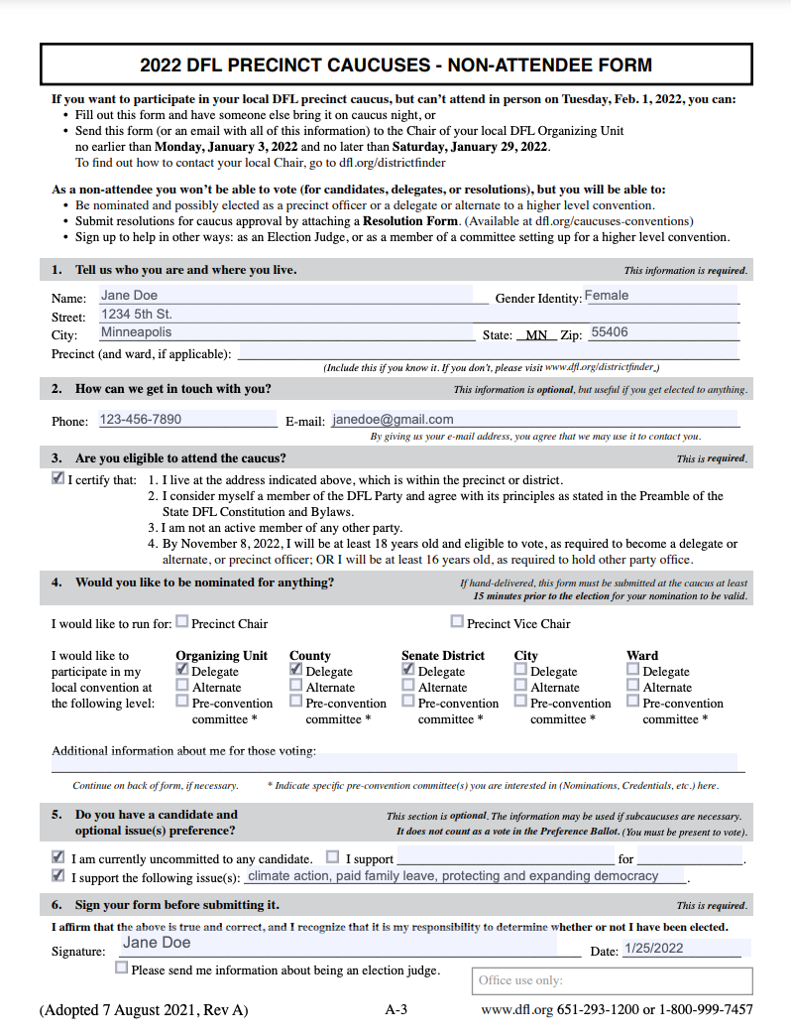
Non-Attendee Form

Slide 12
Four Levels of Caucus and Conventions
Precinct Caucus
Organizing Unit Convention
Congressional District Convention
State Convention

Slide 13
Organizing Unit Conventions
Delegates elected at their local precinct caucuses attend the local Organizing Unit Convention to:
Endorse candidates for State Senate and House
Elect party unit & State party officers
Vote on resolutions Convention and inclusion in the Party Platform
Notes:
ALSO:
Elect delegates to their Congressional District and StateConventions
Consider amendments to the party unit constitution

Slide 14
Four Levels of Caucus and Conventions
Precinct Caucus
Organizing Unit Convention
Congressional District Convention
State Convention

Slide 15
Congressional District Convention
Delegates elected at their Organizing Unit attend the Congressional District Convention to (among other things):
Endorse a candidates
Elect members to serve on State Standing Committees and State Convention Committees
Elect State Directors to serve on the State Executive Committee
Notes:
Endorse a candidate for U.S. Congress
Elect Congressional District party unit officers
Elect members to serve on the State CentralCommittee
Elect members to serve on State StandingCommittees and State Convention Committees
Elect State Directors to serve on the State ExecutiveCommittee
Consider amendments to the Congressional Districtconstitution

Slide 16
Four Levels of Caucus and Conventions
Precinct Caucus
Organizing Unit Convention
Congressional District Convention
State Convention

Slide 17
State Convention
Delegates elected at their Organizing Unit attend the State Convention to:
Endorse candidates for:
  Governor/Lt. Governor
  Attorney General
  Secretary of State
  State Auditor
Consider amendments to the Party Constitution and Bylaws
Consider resolutions for inclusion in the Party Ongoing Platform and Action Agenda
Notes:
SIMPLIFY

Slide 18
How do we use this structure to build worker power in Minnesota?
In 2018, only 34,329 people attended a DFL Precinct Caucus
In 2022, only 18,412 people attended a GOP Precinct Caucus
MAPE’s 18,000+ workers are across all Senate Districts
If 20% of members from each of MAPE’s 39 locals attended their precinct caucus, how could that shift power?
What would energize members to attend their precinct caucus and get involved in the caucus and convention process?

Slide 19
Quick Recap!
February 3:
Caucus Day
Attend precinct caucus/Submit Non-Attendee Form
Submit Resolution
RAISE YOUR HAND/CHECK THE BOX to become a delegate to endorsing conventions
February - April:
If Chosen as a Delegate
Receive calls from candidates
Tell them what you expect from them – the Working People's Agenda!
March - April
Attend Endorsing Convention
Vote for Candidates who are committed to co-governing with us on our Working People's agenda

Slide 20
Building a Working People’s Agenda
Our priorities should:
Energize members
Push bold, transformational change
Deliver real benefits for Minnesotans
Center the needs of the working class
Shape the party agenda and grow our power

Slide 21
Building a Working People’s Agenda
STEP 1 – SHOW UP TO CAUCUS
3,000 MAPE members strong
Tuesday, Feb. 3 · 7 p.m.
STEP 2 – ORGANIZE IN OUR SENATE DISTRICTS
3,000 members leading the fight
March–April · Saturday & Sunday
STEP 3 – BRING IT TO STATE CONVENTIONS
300 delegates shaping our agenda
Two days in June
Notes:
One of the most effective levers of state power that we can wield is through the caucus and convention process, where just a few hundred people shape party endorsements of candidates to elected office.
By showing up together, we can shape the candidates and party platforms with our agenda for higher wages, more time, and investments in the public good.
Our goal is over 3,000 MAPE-represented workers take this action across the state to build our collective power and set the agenda for the 2027 legislative session

Slide 22
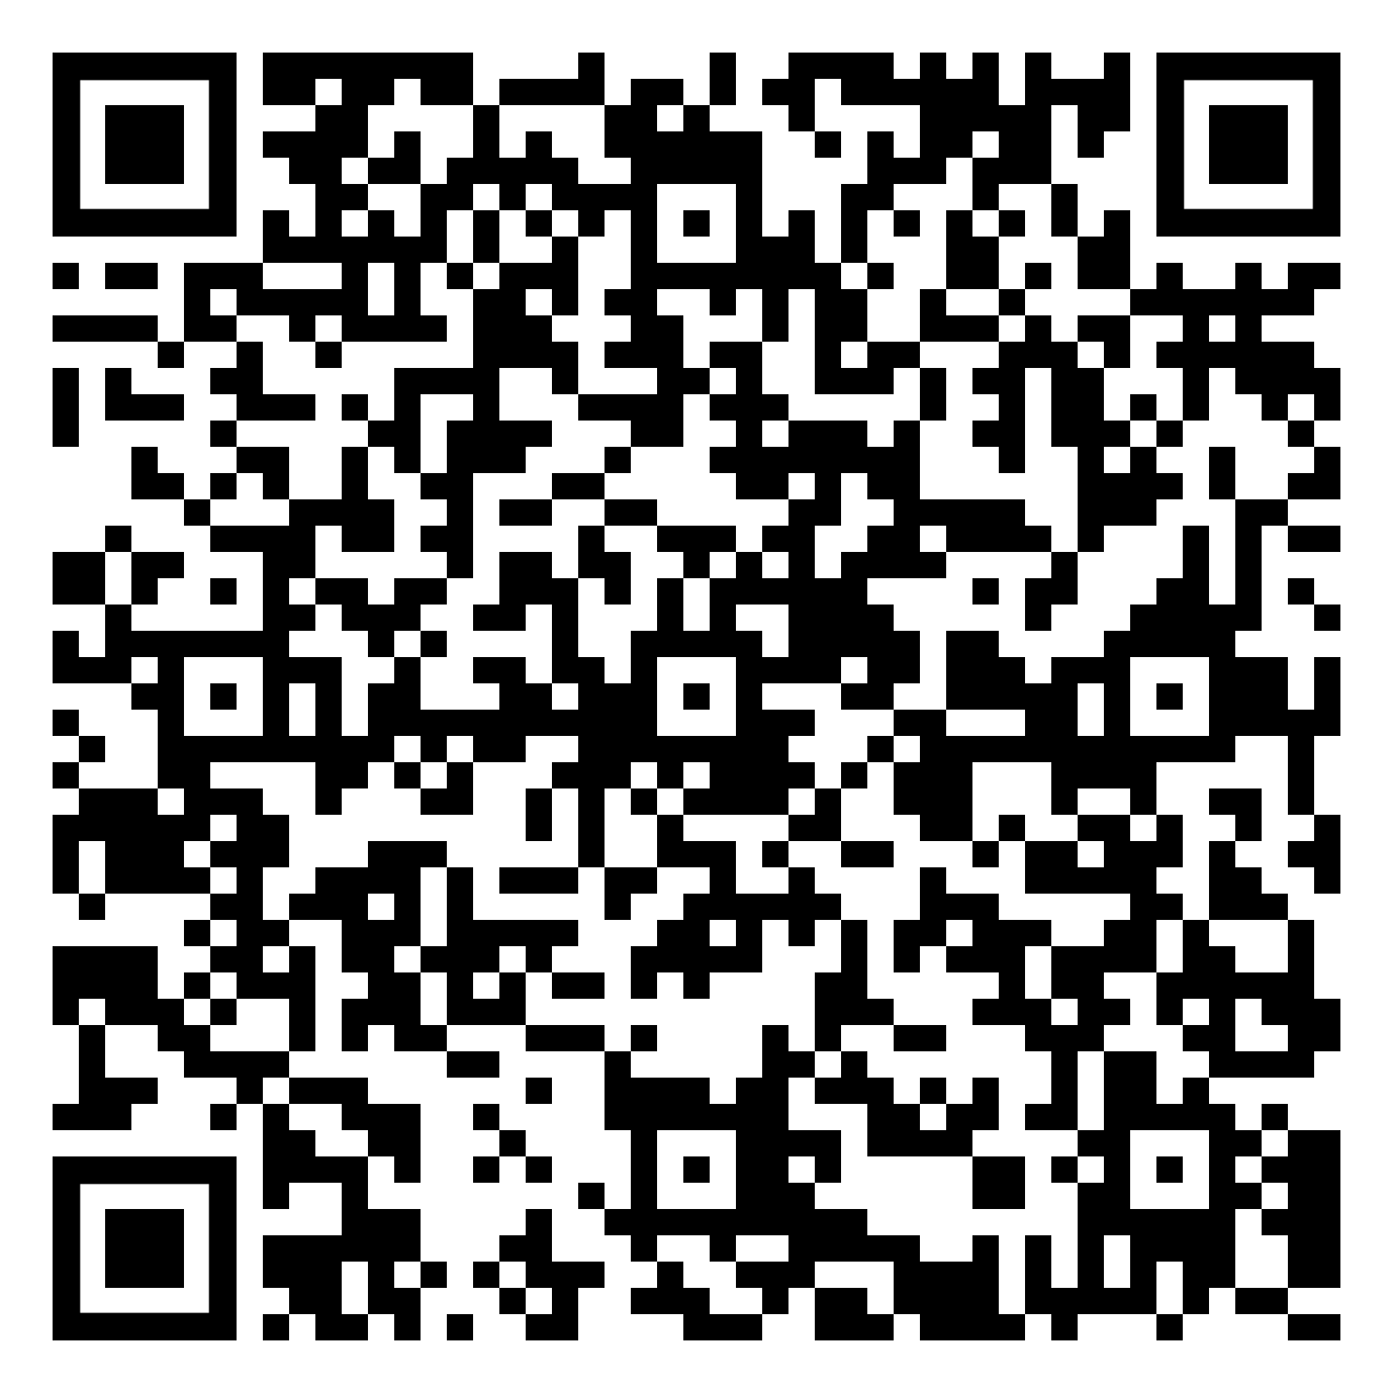
Commit to Caucus!
  Sign the Caucus Commitment Form:
Notes:
https://forms.office.com/pages/responsepage.aspx?id=pH3RRPh-dEqOTzzTdfDeqKFbIn_IwftOqJ8yqbV8kRtUQUpGUkhLRjdZU0ZRRE5JMTROREJSRUJYWC4u&route=shorturl

Slide 23
Civic Engagement Officer Opportunity
The Civic Engagement Officer is a local member organizer who will help build local political power by organizing participation in precinct caucuses, party conventions and advancing a Working People’s Agenda that reflects our shared goals.
No prior organizing experience is necessary; what matters most is a commitment to collective power and making a difference.
The next CEO training will be held at the MAPE office on Friday, Sept. 30, 2025
If you are interested, have questions, or want to talk through how to get started, please contact Lindsey Franklin, Andrew Ulasich, or James Dirth.
Notes:
Participate in the Union Power Project training program (Phase I September - December)
Work with Membership Secretary, Vice President and other local leadership to build an Organizing Committee at the local level
Lead efforts to organize (a goal of) 20% of represented workers in your local to participate in the caucus and convention process (by February 3,2026)
Coordinate and/or facilitate State Power sessions on the State Budget, Healthcare, and 32-hourWorkweek this fall (materials will be provided and facilitation help will be available)
Lead caucus trainings in December and January (no experience necessary; you'll be trained to do this)
We are seeking funding from MAPE's Union Power Project for up to 8 hours of lost time per month(Aug-Dec) for training and organizing work that wehope to make available to Civic Engagement Officers
Civic Engagement Officer Interest Form
Precinct Caucus Commitment Form

Slide 24
Political Council Membership
Nicole Juan, Chair
Local 2101
James Dirth, Secretary
Local 201
Lindsey Franklin
Local 101
Jon VanOeveren, Vice Chair
Local 1002
John Ferrara
Local 2001
Marijke Decuir
Local 902

Slide 25
TITLE
Contact:
Nicole Juan
Political Council Chair
njuan@mape.org
MAPE Political Council Webpage:
https://mape.org/committees/political-council
Notes:
PPT & Full legislative priorities will be posted at:

Slide 26
The state works because we do!
Solidarity.

