Slide 1
Delegate Assembly 2023 October 27-28 Recap

Slide 2
What is Delegate Assembly?
Delegate Assembly (DA) is MAPE's highest governing body. Its powers include, but are not limited to, the authority to establish MAPE policies, approve budgets, levy dues, amend the governing documents, and adopt procedures for statewide, regional and local officer elections.

Slide 3
Region 20 Delegation
Regional Director, Kay Pedretti, Winona State
Local President, Steven Speltz, MPCA - Roch
Delegates: Jon Krusmark – RCTC – Rochester
Kristine Hernandez - MDOT – Rochester
Kristen Gallo - DOC - Red Wing
Alternates:
Nicole Sokolofsky - DHS - Blooming Prairie
Samantha Schendzielos - RCTC – Rochester
Angela Christle – DEED – Rochester
Cathy Finken – DEED – Rochester
Notes:
Delegates vote on the Budget and Resolutions. Here today to share what is going on garner feedback to consider in my vote.

Slide 4
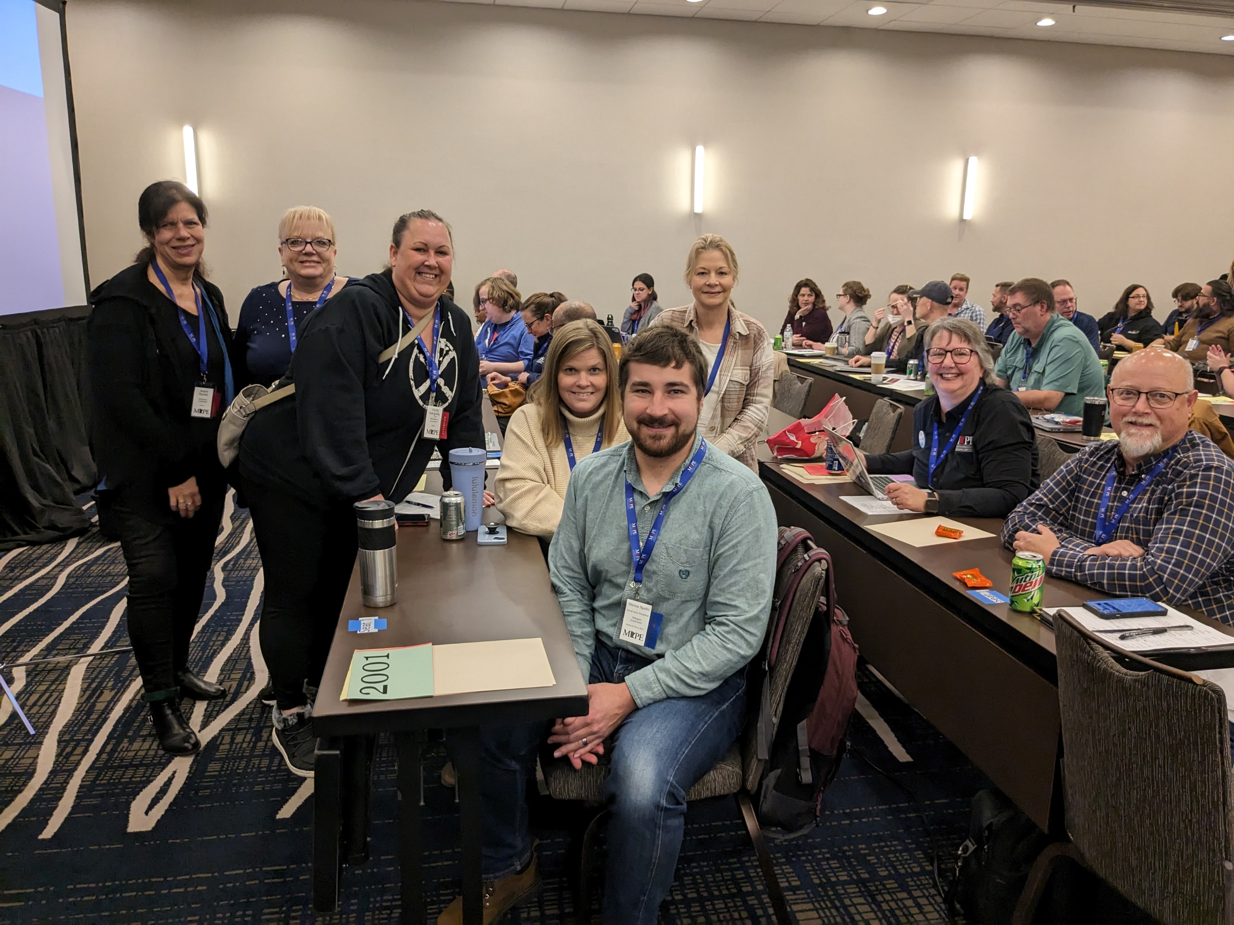
Region 20 Delegation
Notes:
Delegates vote on the Budget and Resolutions. Here today to share what is going on garner feedback to consider in my vote.

Slide 5
What Happened in 2023
Presentation from Organizing Council
Presentation from Political Council
Address from MN House of Representatives Speaker Melissa Hortman
Speaker - Peter Rachleff of the Eastside Freedom Library
Minnesota’s long and rich labor history.
1930’s Strikes at Hormel and the Minneapolis Teamsters.
Current UAW Strike
Notes:
Delegates vote on the Budget and Resolutions

Slide 6
What Happened in 2023
3 Resolutions
Employee Rights Committee members to choose their own titles but may not use the word “Chief.”
For Statewide and Regional Director Positions term limit, 2 - 4 year terms
Elections for Negotiations Representative will occur in Spring 2024.
Notes:
Delegates vote on the Budget and Resolutions

Slide 7
Budget/Dues
Delegates Voted to Pass the Proposed 2024 Budget and Dues Increase. Dues Change
Currently all members pay $21 per pay period.
Change to 45 minutes of Hourly Pay, Cap $32.50
Effective January 1, 2024 Example: Hourly rate of pay $35/hr
$35*.75 = $26.25 per pay period
Notes:
Delegates vote on the Budget and Resolutions

Slide 8
Budget/Dues
Last dues change was in 2013.
Keep up with economic realities.
MAPE will exhaust
Move too equitable contribution structure
Areas of planned increased investment
Negotiations
Data/analytics/information management
Accessibility
Professional Staff
lost time
Notes:
Delegates vote on the Budget and Resolutions

Slide 9
Budget/Dues
How did we get here
2022-2027 Strategic Plan
Finance Workgroup charged with proposing a Dues Structure, Equitable, Sustainable
Finance Workgroup considered 60+ Proposals
Board of Directors Voted to send the 2024 Budget and Dues increase to Delegate Assembly.
Notes:
Delegates vote on the Budget and Resolutions

Slide 10
The state works because we do!
Solidarity

Slide 11
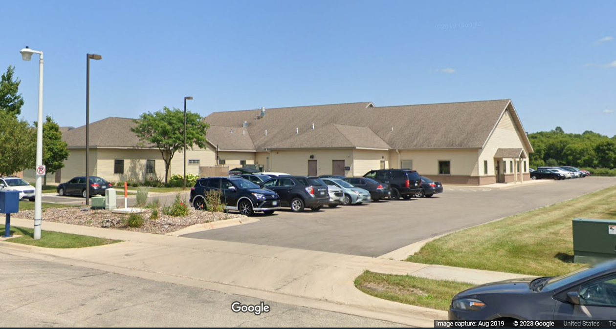
October 19 CBHH Rochester Visit
Regional Director, President and Business Agent
12 MAPE Represented Folks
Workplace Concerns
Staffing
Safety
Advancement
Start a Meet and Confer with Onsite Management to Address concerns
Notes:
Delegates vote on the Budget and Resolutions

Slide 12
UAW Strike
Started September 15, 2023
Implement a STAND UP Strike strategy.
Those on strike grows over time.
Settled with Ford October 25,
Stellantis October 28 and GM October 30
Wins
25% Pay increase by 2028
Starting wage min $30
Brings back benefits lost during the Great Recession
Notes:
Delegates vote on the Budget and Resolutions

Slide 13
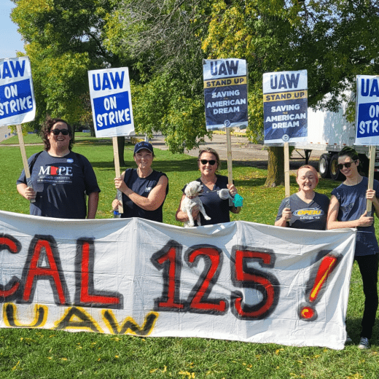
UAW Strike
Notes:
Delegates vote on the Budget and Resolutions

